Slide 1
Big Oh

Slide 2
Intro/Motivation

Slide 3
What is efficiency?

Slide 4
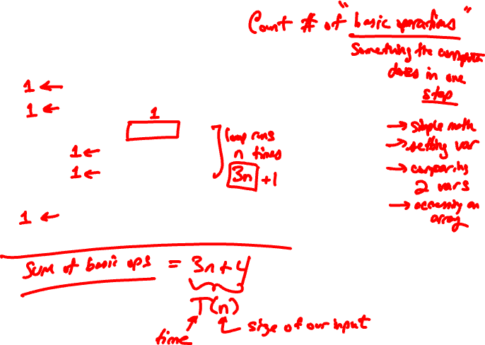
(Example 1)
float mean(int a[], int n) {
sum = 0; (line 1)
i = 0; (line 2)
while (i < n) { (line 3)
sum += a[i]; (line 4)
i++; (line 5)
}
return sum / n; (line 6)
}

Slide 5
Def'n of big-oh
T(n) is O(f(n)) if and only if there exists some positive constant c such that T(n) <= c * f(n) for all sufficiently large values of n. Even more formally: T(n) is O(f(n)) if and only if
∃c, n₀ ∀n > n₀ T(n) <= c * f(n)
[ c and n₀ should be positive real numbers ]

Slide 6
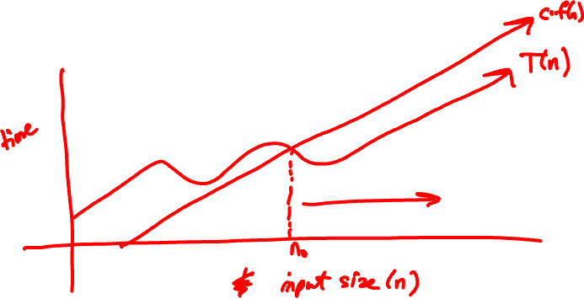
T(n) is O(f(n)) if and only if there exists some constant c such that T(n) <= c * f(n) for all sufficiently large values of n. Even more formally: T(n) is O(f(n)) if and only if
∃c, n₀ ∀n > n₀ T(n) <= c * f(n)

Slide 7
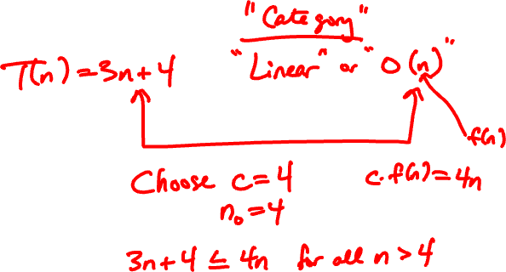
More

Slide 8
Let's show T(n) = 3n+4 = O(n)

Slide 9
Rules of big-oh

Slide 10
Rules of big-oh

Slide 11
Why do we do this?
Why not just use a stopwatch?
Why not just report T(n) for an algorithm?

Slide 12
Why do we do this?
Why drop coefficients and only keep the term that grows the fastest?

Slide 13
Examples

Slide 14
Categories

Slide 15
Graph (+ website)

Slide 16
Shortcuts
You don't have to determine the exact T(n) for a section of code to compute big-oh. There are shortcuts.
Loops: (Example 2)
for (int i = 0; i < n; i++) {
System.out.println("Hello world!")
}

Slide 17
Shortcuts
Nested loops: (Example 3)
for (int i = 0; i < n; i++) {
for (int j = 0; j < n + 25; j++) {
System.out.println("Hello world!")
}
}

Slide 18
Shortcuts
Consecutive Statements: (Example 4)
for (int i = 0; i < n; i++)
a[i]=0;
for (int i = 0; i < n; i++) {
for (int j = 0; j < n + 25; j++) {
System.out.println("Hello world!")
}
}

Slide 19
Logarithmic time
An algorithm takes logarithmic time --- O(log n) --- if it repeatedly cuts the size of the problem by a constant fraction (usually ½).
Binary search is O(log n).

Slide 20
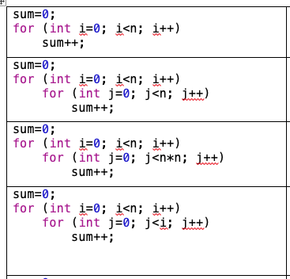
What is the tightest big-oh?
#1
#2
#3
#4

Slide 21
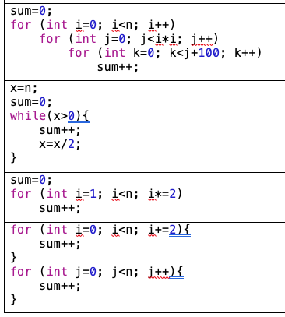
#5
#6
#7
#8

Slide 23
Linear Search
int search(int arr[], int n, int x)
{
int i;
for (i = 0; i < n; i++)
if (arr[i] == x)
return i;
return -1;
}

Slide 25
int binarySearch(int arr[], int l, int r, int x)
{
while (l <= r)
{
int m = l + (r - l)/2;
// Check if x is present at mid
if (arr[m] == x)
return m;
// If x greater, ignore left half
if (arr[m] < x)
l = m + 1;
// If x is smaller, ignore right half
else
r = m - 1;
}
// if we reach here, then element was
// not present
return -1;
}

Slide 26
Ignoring constants – good and bad

Slide 27
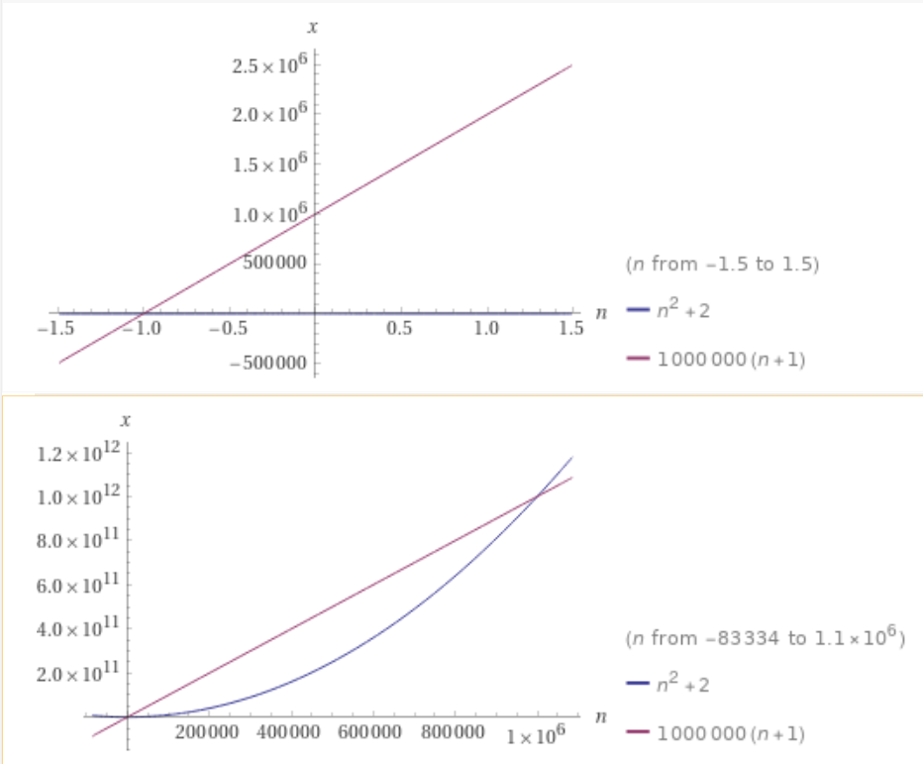
Graphs

Slide 28
Ignoring constants – real world

Slide 29
Big-oh of RArrayList

Slide 30
Big-oh of RArrayList

Slide 31
Analyzing recursive functions

Slide 32
